Slide 1
Challenger Energy Group PLC
Uruguay AREA OFF-1 Update
April / May 2023

Slide 2
Disclaimer
This presentation (“Presentation”) has been prepared by Challenger Energy Group PLC (“Challenger” or the “Company”) solely for the purposes of providing information on the Company and its projects and prospects. This Presentation should not be considered as the giving of investment advice by the Company or any persons, including to any of its shareholders, officers or advisers. If you are in any doubt about the contents of this Presentation or the action you should take, you should consult an independent adviser authorised to render such advice.
This Presentation has not been independently verified and is subject to material updating, revision and further amendments without notice. The Presentation does not purport to contain all information that an investor in or creditor to the Company or its projects may wish to receive for the purposes of assessment or valuation and is not intended to form the basis of any investment or financial decision.
While the information contained herein has been prepared in good faith, neither the Company nor its shareholders, directors, officers, agents, employees, or advisors give, has given or has authority to give, any representations or warranties (express or implied) as to the achievement or reasonableness of future projections, management targets, estimates, prospects or returns contained in this Presentation, or in relation to the accuracy, reliability or completeness of the information in this Presentation, or any revision thereof, or of any other written or oral information made or to be made available to any investor (all such information being referred to as “Information”).
So far as permitted by law, neither the Company nor any of its shareholders, directors, officers, agents, employees or advisers take any responsibility for, or will accept any liability in respect of, the accuracy, reliability or completeness of the Information or for any loss, howsoever arising from the use of this Presentation. In furnishing this Presentation, the Company does not undertake any obligation to provide any additional information or to update this Presentation or to correct any inaccuracies in, or omissions from, this Presentation which may become apparent.
This Presentation contains certain statements which may constitute forward-looking statements. All statements in this Presentation, other than statements of historical facts, that address future activities and events or developments that the Company expects, are forward-looking statements. Although the Company believes that the expectations reflected in these statements are based on reasonable assumptions, such statements are only predictions and are subject to inherent risks and uncertainties and changes in the underlying assumptions which could cause actual values, results, performance or achievements to differ materially from those expressed, implied or projected in any forward-looking statements. Factors that could cause actual results to differ materially from those in forward-looking statements include market prices, continued availability of capital and financing, and general economic, market or business conditions. Investors are cautioned that any such statements are not guarantees of future performance and that actual results or developments may differ materially from those projected in forward-looking statements.
The Company will not undertake any obligation to release publicly any revisions to these forward-looking statements to reflect events, circumstances or unanticipated events occurring after the date of this Presentation, except as required by law or by any appropriate regulatory authority. Nothing in this Presentation or in documents referred to in it should be considered as a profit forecast. Past performance of the Company or its shares cannot be relied on as a guide to future performance.
This Presentation does not constitute, or form part of or contain any offer or invitation to sell or issue, or any offer to subscribe for, underwrite or otherwise acquire, or dispose of, any securities in the Company in any jurisdiction and is directed at, and is only for distribution in the United Kingdom to persons reasonably believed to fall within Article 19 (Investment professionals) or Article 49 (High net worth companies, unincorporated associations etc.) of the Financial Services and Markets Act 2000 (Financial Promotion) Order 2005 (SI 2005/1529) or to whom this Presentation may otherwise lawfully be distributed.
Neither this Presentation nor any part of or copy of it may be taken or transmitted, directly or indirectly, into the United States of America or Canada or distributed or re-distributed directly or indirectly, in the United States of America, its territories or possessions, or Canada, or to any resident thereof except in compliance with applicable securities laws. Any failure to comply with these restrictions may constitute a violation of applicable U.S. or Canadian securities laws. This Presentation and the information contained herein do not constitute an offer of securities for sale in the United States. By accepting this Presentation, the recipient represents and warrants that it is a person to whom this Presentation may be delivered or distributed without a violation of the laws of any relevant jurisdiction. This Presentation is not to be disclosed to any other person or used for any other purpose and any other person who receives this Presentation should not rely or act upon it.
The delivery or distribution of this Presentation in or to persons in certain jurisdictions may be restricted by law and persons into whose possession this Presentation comes should inform themselves about, and observe, any such restrictions. Any failure to comply with these restrictions may constitute a violation of the laws of the relevant jurisdiction.
By attending a meeting where this Presentation is made or distributed, or by reading the Presentation slides, you agree to be bound by these provisions.
Challenger Energy – Uruguay AREA OFF-1 Update – April/May 2023

Slide 3
KEY TAKEAWAYS
Initial prospect inventory of 1 to 2 billion barrels has been defined from CEG’s 2023 2D seismic reprocessing work
Three sizeable prospects have thus far been identified, from a range of play types, consistent with those de-risked by recent successful conjugate margin drilling in Namibia
Prospects are seismically-derived, and supported / further de-risked by AVO analysis
Play robustness is corroborated by geochemical seabed sampling and satellite seep analysis
Conjugate margin success, competitive recent licensing rounds in Uruguay, and technical
uplift from CEG’s 2023 work will drive farm-out process, soon to be initiated
Challenger Energy – Uruguay AREA OFF-1 Update – April/May 2023

Slide 4
URUGUAY AREA OFF-1: UPDATE HIGHLIGHTS
CEG’s 2023 geotechnical work program has identified / confirmed multiple independent plays and prospects on AREA OFF-1
Two material Cretaceous stratigraphic plays – prospects are named “Teru Teru” and “Anapero”
  Cretaceous shelf margin turbidites, each > 400 km²
  AVO supported, located in ~ 750m water depth and with a reservoir depth of ~ 4,000 meters
  Analogous petroleum system and reservoir age to Namibian ultra-deepwater discoveries
  Estimated EUR of >500 MMBOE per prospect (subject to final volumetric determination)
Early Cretaceous stratigraphic play – prospect is named “Lenteja”
  Syn-rift alluvial fan, well defined from 2023 reprocessed 2D, > 400 km²
  Analogous to proven legacy shelf discoveries in Namibia and South Africa
  Large stratigraphic trap in 85 meters water depth
  Estimated EUR of ~ 500 MMBOE (subject to final volumetric determination)
Plays identified from reprocessed 2D seismic have been corroborated by extensive additional technical de-risking work, including:
  Seismic - AVO attribute analysis (Amplitude Variation with Offset)
  Geochemistry seabed sampling
  Satellite seep and slick imagery study
Commercial objective is to secure partner(s) to fast-track participation in a multi-client 3D acquisition
  Farm-out dataset and virtual data room compiled; process to shortly be formally launched
Challenger Energy – Uruguay AREA OFF-1 Update – April/May 2023

Slide 5
AREA OFF-1 Overview

Slide 6
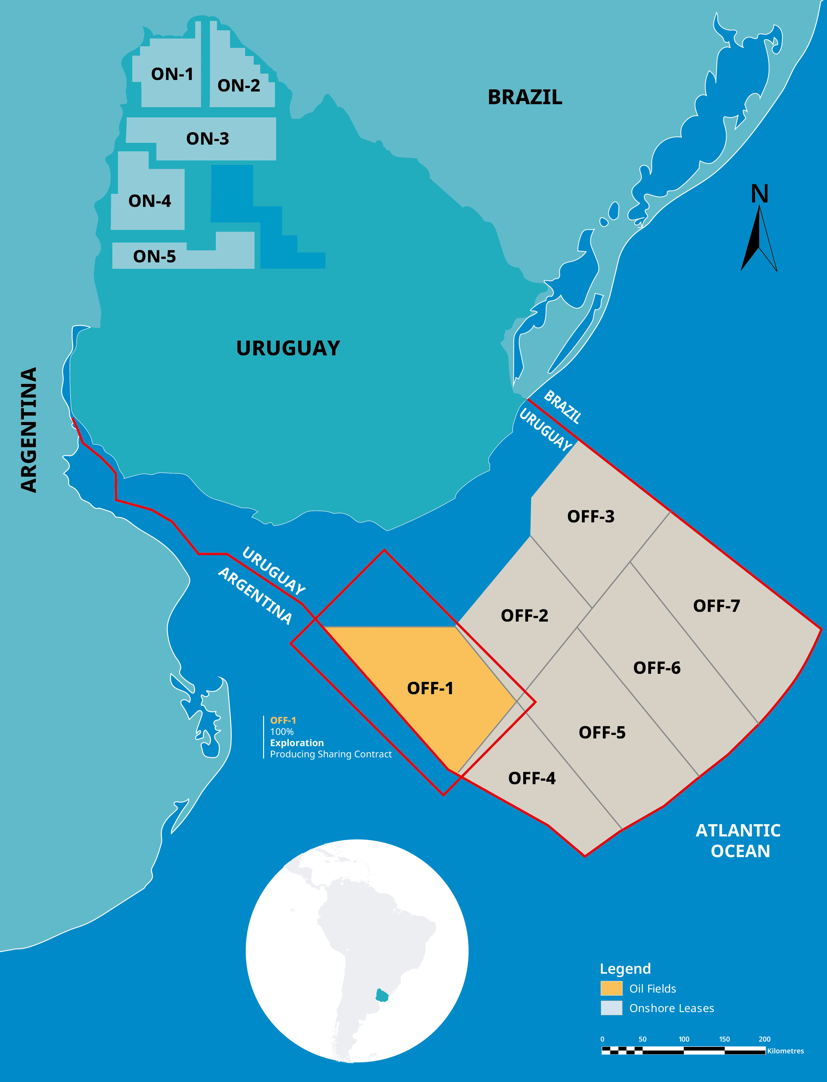
URUGUAY AREA OFF-1: AT A GLANCE
14,557 km² AREA OFF-1 licence area; CEG has 100% working interest
~ 100 kms offshore in Punta del Este basin; underexplored area; only 3 historic wells in the basin that covers >80,000 km², 2 wells drilled mid-70’s on AREA OFF-1, oil shows in both
Moderate water depth, prospects in 85-800m on shelf and continental margin (considerably shallower than ultra-deepwater Namibian discoveries)
LARGE OFFSHORE LICENCE WITH
RUNNING ROOM
Multiple, independent plays have now been identified, corroborated and calibrated from CEG’s work
Material Cretaceous turbidite stratigraphic plays, with source and reservoir similar to Namibian ultra-deepwater super-discoveries
Early Cretaceous play, analogous to proven discoveries in Namibia and South Africa, but in shallower waters
Moderate reservoir depths at 3,800 to 5,000 meters
EXPLORATION
PLAY DIVERSITY
1 to 2 billion barrels of oil recoverable identified from three prospects (thus far, subject to final volumetric assessment)
De-risked by regional analogues and “mega” conjugate margin discoveries
Uruguay has become a global exploration hotspot
GLOBAL SCALE
& MATERIALITY
LOW COUNTRY RISK ATTRACTIVE LICENCE AND FISCAL TERMS
Initial 4-year exploration period has low-cost work commitments, initial term commenced 25/8/2022; 30-year tenure (with potential 10-year extension)
Uruguay is the top ranked country in South America for political risk, social stability, control of corruption and rule of law
Globally competitive, upper quartile fiscal regime; no bonus / royalties
Challenger Energy – Uruguay AREA OFF-1 Update – April/May 2023

Slide 7



AREA OFF-1: KEY LICENCE TERMS
Key Licence Data
Exploration Periods & Work Commitments
100%
WI & Operatorship
100% working interest
(no restriction on farm-outs / strategic partnerships); CEG is the Operator
Low-cost Initial 4-year exploration period
Commenced 25 August 2022, already substantially fulfilled
Geological evaluation & studies including resource estimation
Licence 2,000 kms 2D seismic data from ANCAP
Seismic reprocessing and interpretation
Licence Tenure
30-years incl. exploration (max 12 years) and exploitation (max 25 years)
10-year extension available after 25 years and 2 years before expiry
Optional 2nd exploration period
A 2-year extension
1,000 work units commitment (equivalent to 500 km² 3D or 5,000 km 2D; or a mix of the two); 50% relinquishment
Fiscal Terms
Cost recovery and R-factor (revenue / cost ratio) based profit split
CEG profits taxed at corporate tax rate (currently 25%)
No signature bonus, royalties or annual licence fees
2nd period, if elected, either a 3-year extension
1 well commitment
(no relinquishment)
OR
ANCAP Participation
Up to 20% participating interest in each commercial field developed on heads-up basis (i.e., no carry); reimbursement of pro-rata past costs
Optional 3rd exploration period
Optional further 3-year extension
1 well commitment with 30% relinquishment
Challenger Energy – Uruguay AREA OFF-1 Update – April/May 2023

Slide 8






AREA OFF-1: JURISDICTION HIGHLIGHTS
Uruguay is widely recognised as the premier Latin-American country for business
Transparent Excellent social and political system Well functioning democracy | Educated and skilled workforce Reliable legal system Stable and well managed economy
 | Democracy Index (Economist Intelligence Unit, 2022, www.eiu.com/n/campaigns/democracy-index-2022/#mktoForm_anchor) | #1 |  | Rule of Law Index (World Justice Report, 2021, www.freedomhouse.org/country/uruguay/freedom-world/2023) | #1
 | Low Corruption (Transparency International, 2022, www.transparency.org/en/cpi/2022/index/ury) | #1 |  | Social Mobility (World Economic Forum, 2020, www.weforum.org/reports/global-social-mobility-index-2020-why-economies-benefit-from-fixing-inequality) | #1
 | Civil Liberties (Freedom House, 2023, www.freedomhouse.org/country/uruguay/freedom-world/2023) | #1 |  | E-Government Development Index (United Nations, 2022, publicadministration.un.org/egovkb/en-us/) | #1
Challenger Energy – Uruguay AREA OFF-1 Update – April/May 2023

Slide 9
Regional & Conjugate Context

Slide 10
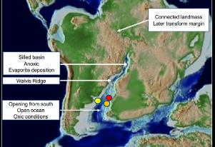
NAMIBIAN SUPER-DISCOVERIES: SIGNIFICANCE TO URUGUAY
Venus (TotalEnergies) and Graff / Jonker (Shell) play opening discoveries, all made since the start of 2022, offshore Namibia, have transformed industry’s perception not just of Namibia, but of the potential of the South Atlantic conjugate margin as well
Namibia & South Africa’s Orange Basin is the direct conjugate basin to the Punta del Este-Salado-Colorado basins along the Uruguay-Argentina continental margin
During the Early Cretaceous (Aptian ~ 125 million years ago), the Gondwana landmass separated, with the African and South American plates unzippering from south to north, in the process creating a narrow marine, restricted seaway
The depositional environment south of the Walvis Ridge, offshore Namibia to Southern Brazil in this seaway was optimal for the deposition of a marine to mixed marine high organic, oil prone source rock material – which has now been calibrated by TotalEnergies and Shell’s Namibian discoveries
Challenger Energy – Uruguay AREA OFF-1 Update – April/May 2023

Slide 11
NAMIBIAN SUPER-DISCOVERIES SIGNIFICANCE CONT….
The Venus and Graff / Jonker discoveries are believed to be charged by an Early Cretaceous Aptian source interval
Significantly, the Early Cretaceous Aptian source interval that charges Venus and Jonker can be seismically correlated to AREA OFF-1’s Punta del Este basin
High amplitude seismic facies from the Cretaceous in the Uruguay / Northern Argentina basins are interpreted as turbidite channels to basin fan reservoirs and high organic source rock intervals, similar to those identified and mapped offshore Namibia
This establishes the potential for a new, prolific petroleum system along the South Atlantic conjugate margin
Challenger Energy – Uruguay AREA OFF-1 Update – April/May 2023

Slide 12

COMMERCIAL IMPACT OF NAMIBIAN SUPER-DISCOVERIES
The Venus and Graff / Jonker discoveries have resulted in a wave of accelerated offshore seismic and drilling activity, and high-value M&A activity, in Namibia and South Africa – a similar trajectory appears likely for the Uruguay / South Atlantic Conjugate margin basins
OFFSHORE DISCOVERIES
OFFSHORE ACTIVITY
TRANSACTIONS
February 2022 – VENUS WELL - TotalEnergies (with partners Qatar Energy, Impact and Namcor), PEL 56, Orange Basin, offshore Namibia -a 3-5+ Bbbl light oil discovery from an Aptian basin floor fan in ultra-deep waters
February 2022 – GRAFF WELL – Shell, PEL 39, offshore Namibia- a reported 0.5 Bbbl light oil discovery, but a different play type than Venus
April 2022 – LA RONA WELL – Shell, PEL 39, Orange Basin, offshore Namibia; Graff - near-field appraisal well, discovery with hydrocarbons confirmed, details unreleased
March 2023 – JONKER WELL – Shell, PEL 39, Orange Basin, offshore Namibia - oil discovery and speculated extension of the Venus fan complex – reportedly larger than either of Graff or La Rona
TotalEnergies – commenced initial campaign for drilling up to four appraisal wells in Namibia in March 2023, objective is to define scale and scope of Venus, and a fast-tracked development
Shell – up to ten wells planned in 2023 / 2024 in Namibia – mix of exploration and appraisal
GALP – well planned for 2023 for PEL83 in Namibia
Maurel & Prom – five well campaign reported for offshore Namibia, commencing 2023
Woodside - PEL87 seismic underway, reportedly half complete
October 2022 - Chevron Farm-in to PEL 90 (offshore Namibia) to Trago for a reported majority interest and operatorship; carry to Trago through seismic campaign and initial exploration well drilling; transaction value circa US$80-100m
March 2023 - Woodside Farm-in to PEL 87 (offshore Nambia) to PanContinental for a 56% working interest, full 3D seismic carry and optional well carry; initial seismic carry estimated at $US35m, with optional well carry
TotalEnergies is prioritizing almost 50% of its global exploration budget to Namibia this year 2023 to appraise Venus, a multibillion-barrel discovery on block 2913b within the Orange Basin. As announced by TotalEnergies CEO Patrick Pouyanné during the company’s 2022 Results & 2023 Objectives presentation
Challenger Energy – Uruguay AREA OFF-1 Update – April/May 2023

Slide 13



CONSIDERABLE REGIONAL ACTIVITY UNDERWAY
  Technical work in the broader regional area is now also being accelerated as a result of conjugate margin discoveries
  Argentina’s 1st deepwater well, Argerich-1 is scheduled to spud Q2 2023
    Equinor operated with partners YPF and Shell
    300 kms offshore in Block CAN-100
    Projected TD of 4,050m; water depth 1,535m
    Estimated to cost ~ US$100m
    Targeting Cretaceous basin floor sandstones similar to Venus in Namibia
  Equinor, in conjunction with partner Argentinian national oil company YPF, is acquiring 3D seismic on Blocks CAN-100, CAN-108 & CAN-114
  Other operators, Shell & Total with partners BP and Qatar Energy, will be acquiring seismic in 2023 / 24
Challenger Energy – Uruguay AREA OFF-1 Update – April/May 2023

Slide 14
URUGUAY HAS BECOME A NEW GLOBAL HOTSPOT
  The technical impact of Venus and Graff / Jonker has already resulted in Uruguay becoming a new global exploration hotspot
  CEG was the first company to enter Uruguay in 2020, pre-dating conjugate margin discoveries offshore Namibia – at the start
  of 2022, CEG was the only licence holder in Uruguay, having bid a modest initial work program and no drilling obligation
  In 2022, Shell, APA (formerly Apache) and YPF were awarded five blocks with substantial work programs
  (unsuccessful qualified parties / bidders included TotalEnerges, CNOOC, Qatar Energy and OXY)
  AREA OFF-3, a shallow water to shelf margin licence, is now the sole remaining offshore acreage open for licencing in Uruguay
AREA / HOLDER | WI % | AWARD DATE | WORK PROGRAM COMMITTMENT | ESTIMATED WP VALUE
AREA OFF-1 CEG | 100 | May 2020 | 2D seismic licencing & reprocessing G&G Studies | ~ US$1m
AREA OFF-2 SHELL (APA also bid) | 100 | May 2022 | Gravity & Magnetic 3D reprocessing G&G Studies | US$10m
AREA OFF-6 APA | 100 | May 2022 | Drilling one well in Period 1 Data licencing; G&G Studies | US$125m
AREA OFF-7 SHELL | 100 | May 2022 | Gravity & Magnetic 3D reprocessing; G&G Studies | US$10m
AREA OFF-4 APA & SHELL* (YPF also bid) | 60/40 | Nov 2022 | Acquisition of 2500 km² 3D seismic Data licencing + G&G | US$40m
AREA OFF-5 YPF | 100 | Nov 2022 | Gravity & Magnetic 3D reprocessing; G&G Studies | US$10m
* APA is operator
Challenger Energy – Uruguay AREA OFF-1 Update – April/May 2023

Slide 15
AREA OFF-1 Technical Update

Slide 16
AREA OFF-1: WORK PROGRAM STATUS (APRIL 2023)
CEG’s initial four-year exploration period (ending 09/2026) work commitment is to licence & reprocess 2,000 kms of legacy 2D seismic, and undertake two Geological and Geophysical (“G&G”) studies
Given the strong emerging interest in Uruguay, and to facilitate a farm-out, this work program has been expanded and accelerated
The first phase is now largely complete, and the full program is on schedule to be completed in Q3 2023
WORK COMPLETED AS AT APRIL 2023
4,760 kms of legacy 2D purchased/licenced from ANCAP
2,100 kms of high-graded 2D seismic fully reprocessed
Acquired and integrated two independent geochemical studies – (i) seabed sampling, and (ii) seeps and slicks satellite study
Completed specialized geophysical and AVO attribute analysis by external experts on six reprocessed seismic lines
Validated primary leads and identified new AVO supported prospects
ADDITIONAL 2023 WORK
Finalise prospect mapping
Complete interpretation of 2023 reprocessed 2D data and merge with legacy seismic
Volumetric assessment and risking of lead/prospect portfolio
Finalise G&G resource estimate (Yet to Find) and exploration potential studies
Additional AVO analysis on further seven lines, and select technical studies to further de-risk
Challenger Energy – Uruguay AREA OFF-1 Update – April/May 2023

Slide 17
AREA OFF-1: KEY TECHNICAL FINDINGS SUMMARY (APRIL 2023)
1.
2D seismic reprocessing has materially uplifted imaging quality, in turn facilitating higher accuracy mapping of existing prospects and allowing for new leads to be identified
AVO attribute analysis of initial six lines has identified a significant AVO anomaly at the southwest boundary of AREA OFF-1, and identified several others (AVO analysis of additional seven lines now in process)
Geochemistry study comprised of seabed box core sampling calibrates the seismic prospects and geospatially aligns with seeps/slicks anomalies, increasing geological confidence and reducing risk
Satellite seep and slick study corroborates the seismically defined primary leads at same locations
3 primary prospects identified, mapped and calibrated
Teru Teru – ~ 460 km², ~ 800m water depth, top reservoir at ~ 4,300m, seismically defined & AVO supported, Class II
Anapero – ~ 500km², ~ 750m water depth, top reservoir ~ 3,800m, seismically defined and AVO supported, Class III
Lenteja – ~ 425 km², ~ 85m water depth, top reservoir at ~ 5,000m, seismically defined
2.
3.
4.
5.
Challenger Energy – Uruguay AREA OFF-1 Update – April/May 2023

Slide 18
AREA OFF-1: SEISMIC REPROCESSING WORKSTREAM
2,100 kms of high-graded legacy 2D seismic data, from 19 lines across AREA OFF-1, was selected from available seismic data-base and reprocessed in time and depth domains
Available Data Set
4,760 kms of legacy 2D
No 3D on the block
Two wells drilled in 1976 by Chevron (Lobo and Gaviotin) on the inner shelf - targeted shallow basement highs, with oil shows from fluid inclusions
Challenger Energy – Uruguay AREA OFF-1 Update – April/May 2023

Slide 19
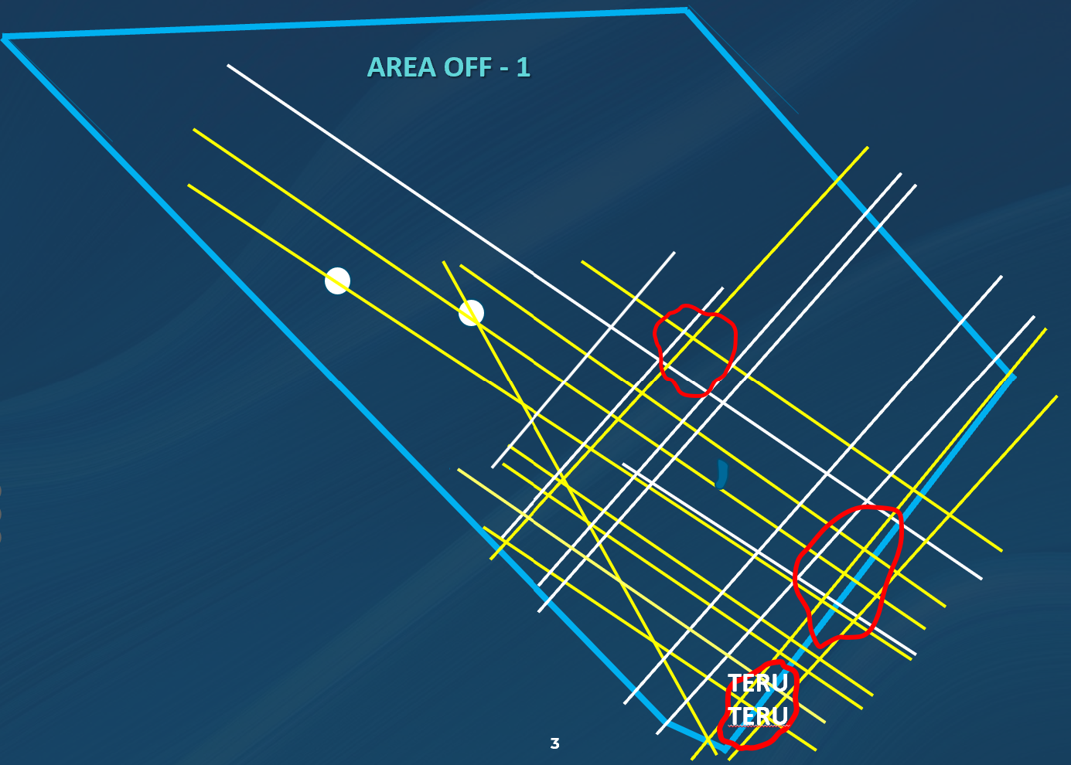
AREA OFF-1: 2023 2D SEISMIC REPROCESSING UPLIFT
Key Outcomes
The reprocessed seismic provides significantly improved data resolution and imaging with enhanced fault definition
Able to better identify seismic facies, refine the prospect geometries, and facilitates AVO attribute analysis
Work was completed by Down Under Geophysical,
a specialist seismic reprocessing firm (UK)
To ensure data and process integrity, a further
layer of technical assurance was derived from
an independent external QC process, in place
throughout the reprocessing workstream
BEFORE
Source: Down under Geophysics

Slide 20
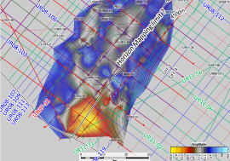
AREA OFF-1: AVO ATTRIBUTE ANALYSIS
In general terms, Class II / Class III Amplitude Variation with Offset (AVO) anomalies are considered to represent porous sands with a potential presence of hydrocarbons
Key Findings
Results thus far indicate stacked sands in the Cretaceous, with good evidence of potential hydrocarbon charge
Various Class II/III AVO anomalies have been identified, indicative of porous sand presence and possible hydrocarbons
AVO analysis is being conducted by LEAN Geosolutions, a specialist firm in advanced seismic attribute evaluation (Houston)
Six reprocessed seismic lines were selected for AVO attribute analysis; based on results, a further seven have now been selected for similar analysis, with work commenced
Line UR07-002P1-021 – UFar 35-45 – Zero phase (Teru Teru prospect)
AVO Class II/III
Indicative of porous sand
Clear reservoir pinch-out seals structure up-dip
Flat Spot
Oil-water contact?
Lower Cretaceous Amplitude Map
~460 km²
Source: LEAN Geosolutions
Challenger Energy – Uruguay AREA OFF-1 Update – April/May 2023

Slide 21
AREA OFF-1: EXPLORATION PROSPECTS
Integration of the 2D reprocessing and AVO attribute analysis has allowed 3 primary
prospects thus far to be identified and mapped
TERU TERU – ~ 460 km², in ~ 800m water
depth, top reservoir at ~ 4,300m, seismically defined & AVO supported, Class II
ANAPERO – ~ 500km², ~ 750m water depth,
top reservoir at ~ 3,800m, seismically defined and AVO supported, Class III
LENTEJA – ~425 km², ~ 85m water depth, top reservoir at ~ 5,000m, seismically defined, possible AVO anomaly in downdip segment
Integration and mapping work conducted by Molyneux Advisors, geotechnical interpretation consultants (Perth)
Historical Wells
Challenger Energy – Uruguay AREA OFF-1 Update – April/May 2023

Slide 22
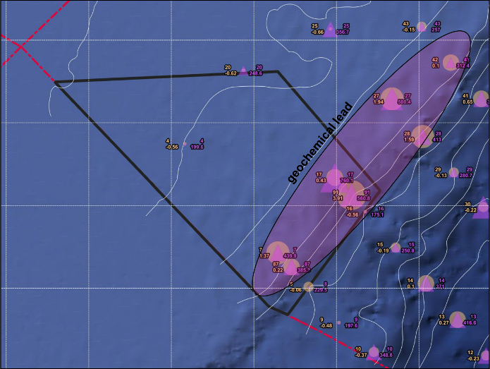
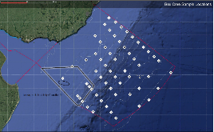
AREA OFF-1: GEOCHEMICAL STUDY
Key Findings
Highest hydrocarbon values are found within AREA
OFF-1 (pink circles on map)
Multipoint geochemical anomaly defined in AREA OFF-1
Hydrocarbon compound responses and signatures are consistent with active petroleum micro-seepage along the continental shelf break of AREA OFF-1 that forms a northeast fairway trend
59 box core seabed samples acquired across all Uruguay blocks, to determine the presence of active petroleum systems and detect micro-petroleum seepage from
subsurface reservoirs
117 geochemical samples from 59 locations were analyzed
for hydrocarbons
Study conducted by Applied Geochemical Imaging (Houston)
C2 to C-8 ( Light Oil) Hydrocarbon Values
Source: Applied Geochemical Imaging
Challenger Energy – Uruguay AREA OFF-1 Update – April/May 2023

Slide 23
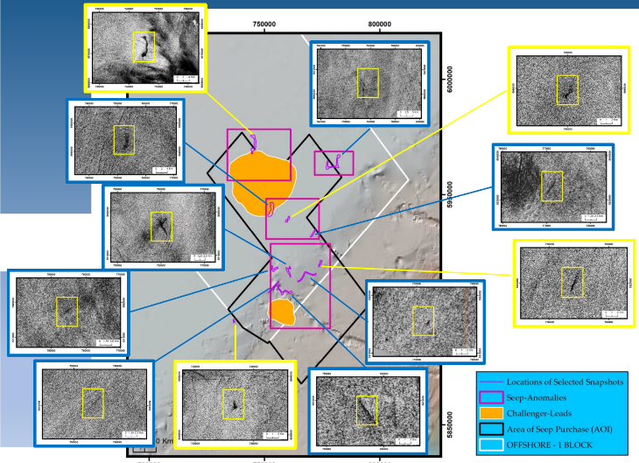
AREA OFF-1: SATELLITE SEEPS & SLICK STUDY
Key Findings
Validated 31 oil seeps, which demonstrate good geospatial alignment to mapped seismic prospects
Study involved using satellite data / images across an area of 4,000 km² over AREA OFF-1, analysed over several decades for repeatability, to evaluate oil seeps and slicks
Study conducted by SAR Satellite Oil Seeps (France)
Source: SAR Satellite Oil Seeps
Challenger Energy – Uruguay AREA OFF-1 Update – April/May 2023

Slide 24
AREA OFF-1: INTEGRATED EXPLORATION PROSPECTIVITY MAP
Play robustness has been
corroborated by the additional
technical derisking workstreams
Geochemistry seabed sampling study calibrates the seismic prospects and geospatially aligns with seeps/slicks anomalies, increasing geological confidence and reducing risk
Satellite seep and slick study corroborates the seismically defined primary leads at same locations
Challenger Energy – Uruguay AREA OFF-1 Update – April/May 2023

Slide 25

AREA OFF-1: TERU TERU PROSPECT
Play Type: ~ Mid-Cretaceous turbidite on outer shelf margin
Similar petroleum system and reservoir type as evident in Venus / Jonker discoveries in Namibia
AVO anomaly Class II identified
Downdip amplitude dims at possible oil-water contact
Indicates porous sand and potential hydrocarbon presence
Areal extent: ~ 460 km²
Located in south-western segment of AREA OFF-1; straddles the AREA OFF-1 / OFF-4 boundary,
but, the up-dip termination for Teru Teru
lies on AREA OFF-1, including the trapped
area above projected oil-water contact
Reservoir Age: ? Ceno-Turonian to Campanian
Reservoir Top Depth: ~4,200 meters
Water Depth: ~ 800 meters
Oil-water contact?
AVO AREA
~ 460 km²
Source: LEAN Geosolutions
Challenger Energy – Uruguay AREA OFF-1 Update – April/May 2023

Slide 26
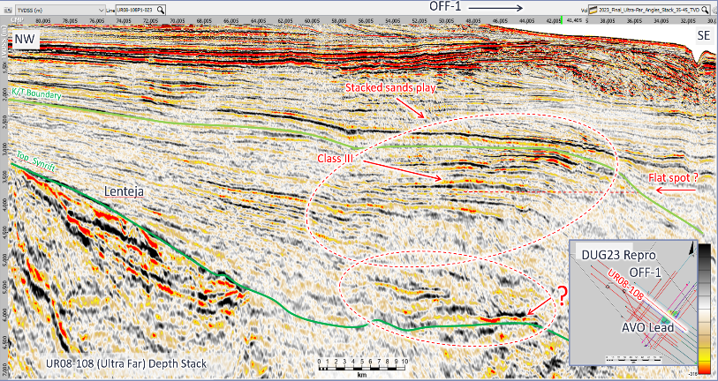
AREA OFF-1: ANAPERO PROSPECT
Line UR08-108 (Utra Far) Depth Stack (Anapero prospect)
Play type: Upper Cretaceous stacked sands on the shelf margin
Similar petroleum system and reservoir type as evident in Venus / Jonker discoveries in Namibia
AVO anomaly Class III identified
strong negative amplitudes on Ultra Fars
indicates porous sand reservoirs are likely
Areal extent: ~ 500 km²
Located in south-central segment of
AREA OFF-1; straddles the AREA OFF-1 / OFF-4 boundary, but the Anapero stratigraphic trap extents are largely inside AREA OFF-1
Reservoir Age: ? Campanian
Reservoir Top Depth: ~ 3,800 meters
Water Depth: ~ 750 meters
Challenger Energy – Uruguay AREA OFF-1 Update – April/May 2023

Slide 27
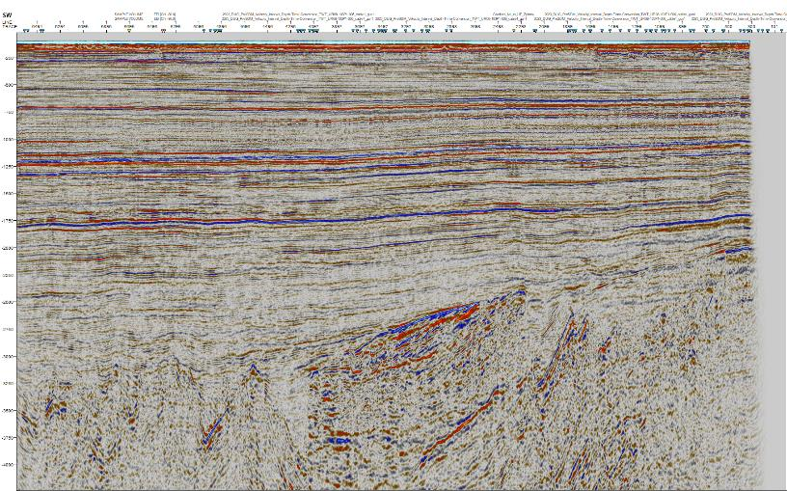
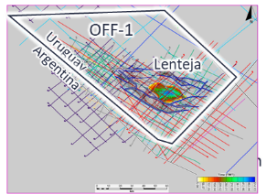
AREA OFF-1: LENTEJA PROSPECT
Play type: Lower Cretaceous alluvial
syn rift fan sealed by a regional unconformity
Analogs to Kudu (Namibia), AJ-1 & Ilhubhesi (South Africa) discoveries
Areal extent: ~ 425 km²
Large stratigraphic closure
Lenteja has a high amplitude seismic facies lens within a NW-SE horst block dips south, with an up-dip unconformable seal
Reservoir Age: Hauterivian-Barremian
Reservoir Top Depth: ~ 5,000 meters
Water Depth: ~ 85 meters
Prospect Lenteja
R
S
Source: Molyneux Associates
Challenger Energy – Uruguay AREA OFF-1 Update – April/May 2023

Slide 28
AREA OFF-1: PROSPECT & VOLUMES SUMMARY (APRIL 2023)
PROSPECT | DEPOSITIONAL ENVIRONMENT | STRATIGRAPHIC AGE | AREAL EXTENT | WATER DEPTH | RESERVOIR DEPTH | ANALOGS | ESTIMATED EUR (mmbl)*
TERU TERU | Onlap slope turbidite to shelf margin delta AVO supported – Class II | Mid to Upper Cretaceous ? Cenomanian - Campanian | ~460 km² | ~800m | ~4,300m | Campos Basin (Brazil) Labrador (Canada) | >700
ANAPERO | Onlap turbidite, wave edge delta shelf margin downlap AVO supported – Class III | Upper Cretaceous ? Campanian | ~500 km² | ~750m | ~3.800m | Nanushuk (Alaska) | >500
LENTEJA | Lacustrine alluvial syn-rift sealed by regional uncomformity | Lower Cretaceous Hauterivian - Barremian | ~425 km² | ~85m | ~5,000m | Kudu (Namibia) AJ-1 and Inhubesi (South Africa) | c. 500
* Estimated EUR is based on existing ANCAP data, public information and initial work done. Formal volumetrics assessment work is ongoing and will be advised once complete.
Challenger Energy – Uruguay AREA OFF-1 Update – April/May 2023

Slide 29
AREA OFF-1: NEXT STEPS – 3D SEISMIC
Commercial objective is to fast-track acquisition of 3D seismic into Year 2 of the first exploration period
3D seismic acquisition would cover the southwest sector of AREA OFF-1 (highlighted on map)
Notional area of up to 5,000 km² defined
Objective is to cover all identified prospects
Estimated cost US$12m to US$25m (dependant on final area and acquisition parameters)
Given the recent licencing of multiple blocks in Uruguay, various seismic vendors are now proposing a multi-client 3D seismic program
Potentially cost synergies from a 12,000 km² acquisition program
Permitting applied for and pending approval from Ministry of Environment and ANCAP
Target to commence in early 2024
AREA OFF-1 3D SEISMIC PROPOSED ACQUISITION AREA
Highlighted area is indicative seismic area on OFF-1
Challenger Energy – Uruguay AREA OFF-1 Update – April/May 2023

Slide 30
Farm-out Process

Slide 31
FARM-OUT PROCESS
Farm-out data set and virtual data room compiled
4,760 kms of legacy 2D purchased and licenced from ANCAP (2022)
2,100 kms of high graded 2D reprocessed in depth and time (Down Under Geophysical, UK – 2023)
1,200 kms of AVO attribute analysis conducted on 13 prioritized lines (six completed, seven more in process)
(LEAN Geosolutions, Houston - 2023)
Uruguay offshore geochemistry seabed sampling study, 59 box core data points (AGI, Houston - 2017)
4,000 km² satellite seep study (SAR Satellite Oil Seeps, France - 2022)
DUG Insight 2D project interpreted with key regional horizons and selected prospects, including volumetrics
(Molyneux Associates, Perth - 2023)
Other block data:
  No 3D acquired on block; regional 3D available for licencing
  Well data for two on-block wells, Lobo & Gaviotin (1976, Chevron)
    LAS, Velocity, Dipmeter & Composite logs, Fluid inclusion report, Rock Physics, Fluid Substitution & petrophysics reports
    Drilled on the inner shelf targeting shallow basement highs, with oil shows from fluid inclusion
Farm-out process will shortly be launched
Seeking bids Q3 2023 and completed farm-out transaction Q4 2023
Challenger Energy – Uruguay AREA OFF-1 Update – April/May 2023

Slide 32
APPENDIX: NAMIBIA PEL87 FARM-OUT vs. AREA OFF-1
 | PEL 87, BLOCK 2713 | AREA OFF-1
Country | Namibia | Uruguay
Basin | Orange | Punte del Este
Area (km2) | 10,970 | 14,557
Play(s) | Lower Cretaceous basin floor fan turbidite | Lower Cretaceous, shelf margin turbidite Lower Cretaceous synrift alluvial fan (stratigraphic)
Reservoir Depth | 5,000m to 6,000m | 3,800-5,000m
Petroleum System | Aptian source with Aptian / Albian reservoirs | Aptian source rock with Albian-Cenomanian reservoirs
Water Depth (m) | 550m to 3,200m | 80m to 800m
Estimated Resource | 1BBOE + (source PanContinental) | 1-2 BBOE (CEG initial estimate, 3 prospects)
3D | None - acquiring new survey in 2023 | None
2D | ? | ~ 5,000kms, reprocessed 2,000kms in 2023
Wells | None | 2 shelf wells drilled in 1976
Distance offshore | Up to 250kms | up to 150kms
Estimated Well Cost | $75m -$100m | $35m - $50m
Farm-out Commercial Terms
Equity Purchased/Transferred | 56%
Farmor | PanContinental-75% (pre farmout)
Farminee | Woodside (option to acquire 56% WI & operatorship) retain 20% carried interest through 1st well
Carry Terms | Pay 100% of min 5,000 km² 3D ($US35mm) Optional full carry on 1st Well – 180 days after seismic receipt to exercise Up to US$4m cash (U$S1.5m upfront)
Challenger Energy – Uruguay AREA OFF-1 Update – April/May 2023

Slide 33
APPENDIX: AVO ATTRIBUTE ANALYSIS PRIMER
Amplitude Variation with Offset (AVO) analysis is the comparison of seismic amplitude brightness from the Near Angle (0-15) stacks to those recorded further offset, being the Far Angles (30-35) and UltraFar (35-45) stacks
This specialist technique is increasingly used in the industry as a tool to guide 3D seismic selection and de-risk prospects pre-drill, because AVO anomalies can be predictive of the presence of reservoir (sand vs shale) and potential hydrocarbons / fluids in reservoir
When evident, identified AVO anomalies are ascribed a class derived from the type of the AVO response
In general terms, Class II / Class III anomalies are considered to represent porous sands with a potential occurrence of hydrocarbons
Source: LEAN Geosolutions
Challenger Energy – Uruguay AREA OFF-1 Update – April/May 2023

Slide 34
Competent Person Statement
Technical work referred to in this presentation has been undertaken by various independent third-party specialist advisors, as indicated.
This technical work has been overseen by Mr. Randolph Hiscock the Company's New Business Director and Uruguay Managing Director.
In accordance with the AIM Note for Mining and Oil & Gas Companies, CEG discloses that Mr. Randolph Hiscock is the qualified person who has reviewed the technical information contained in this presentation. He has a Masters in Science (Geology) and is a member of the AAPG & PESGB, and has over 35 years' experience in the oil and gas industry. Randolph Hiscock consents to the inclusion of the information in the form and context in which it appears.
Challenger Energy – Uruguay AREA OFF-1 Update – April/May 2023

